Slide 1
ISQ Awareness Session

Slide 2
IBP Superior Qualification
Junior Associateship of IBP 12 Subjects
Associateship of IBP 5 Subjects

Slide 3
ISQ: Eligibility Criteria
Banking and Finance industry professionals;
or
Graduate in any discipline with a minimum 2nd Division or Equivalent;
or
Candidate in the final year of graduation (14years) studies; or in the 3rd year of graduation (16years) studies;
or
Candidate enrolled in Professional Accounting qualifications.

Slide 4
ISQ: Program Fee
Registration fee (one-time): PKR 15,000/-
JAIBP Examination fee (Stage-I) PKR 2,000/- (Per Subject)
JAIBP Examination fee (Stage-II): PKR 2,500/- (Per Subject)
JAIBP Examination fee (Stage-III): PKR 3,000/- (Per Subject)
AIBP Examination fee: PKR 2,500/- (Per Subject)
JAIBP Exemption fee: PKR 2,500/- (Per Subject)

Slide 5
ISQ: Exemption Policy
Candidates can avail exemptions up to 02 subjects in JAIBP if they have completed similar subjects in their academic qualifications.
Candidates can avail exemptions up to 06 subjects in JAIBP if they have completed similar subjects in their professional studies (ICAP, ICMAP, PIPFA and ACCA-UK).

Slide 6
ISQ: Passing Criteria
Minimum 50 % marks each in Objective & Subjective Sections of the Examination paper.

Slide 7
ISQ: Time Limitation Policy
Candidate will be given a time frame of 08 years from the date of registration to complete JAIBP.
If the candidate is unable to complete the JAIBP program in 08 years, all of the complete and incomplete stage(s) will be lapsed and the candidate(s) will be required to enroll in JAIBP again as a fresh candidate.
Candidate registered prior to Winter-2015 [Having attempts/at least last attempt remaining in Winter-2015] will be allowed 08 years from Winter-2015 to complete their JAIBP. If the candidate is unable to complete the JAIBP program by Summer-2023, all of the complete and incomplete stage(s) / part(s) will be lapsed and the candidate(s) will be required to enroll in JAIBP again as a fresh candidate.

Slide 8
ISQ: Comprehensive Exam
Eligibility Criteria:
The Institute offers the comprehensive bridge exam for those candidates who have successfully completed their JAIBP program prior to Winter-2011 (as per old ISQ Course Structure) and would like to get Chartered Banker certification and become eligible for use of Associate Chartered Banker title.
OR
Bankers with 07 years of banking experience are eligible to appear for comprehensive (06 hours) examination covering core subjects of JAIBP, which will lead towards JAIBP qualification, and are also eligible to attain the title of ASSOCIATE CHARTERED BANKER from CHARTERED BANKER INSTITUTE (UK).

Slide 9
ISQ: Comprehensive Exam
Program Fee:
    Registration fee: 15,000/-
    Exemption fee: 30,000/-
    Examination fee: 9,000/-
    Total Fee: 54,000/-

Slide 10
IBP Microfnance Diploma (IMFD)
    Research Report
    Written Exam
Fee Structure:
IBP Microfinance Diploma Registration & Exam Fee
(1st Time) PKR 12,000/-
Re-take Fee (2nd and 3rd attempt) Examination Fee/ Report Fee/ Both
    (Re-take) PKR 3,000/-

Slide 11
Professional Banker
Eligibility Critera:
The entry criteria for the Professional Banker Certificate program is enrollment in any graduate program.
Professional Banker Certification Courses:
    Business Communication for Financial Services
    Introduction to Financial Systems and Banking Regulations
    Information Technology in Financial Services
    Branch Banking
    Lending: Products, Operations and Risk Management
    Human Resource Management and Organizational Behavior

Slide 12
Professional Banker
Exam Erollment Fee:
    Business Communication for Financial Services PKR 2,000/-
    Introduction to Financial Systems and Banking Regulations PKR 2,000/-
    Information Technology in Financial Services PKR 2,000/-
    Branch Banking PKR 2,000/-
    Lending: Products, Operations and Risk Management PKR 2,500/-
    Human Resource Management and Organizational Behavior PKR 2,500/-

Slide 13
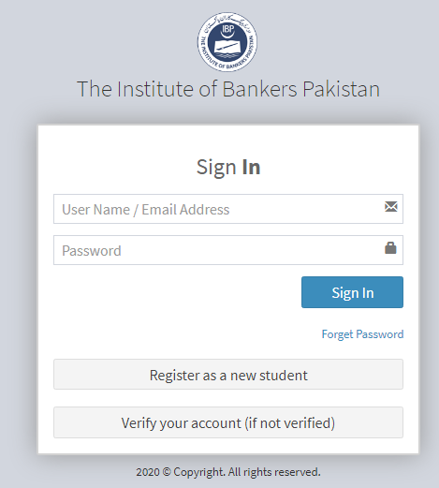
ISQ Enrollment Portal
http://100.42.50.26/Login.aspx
List of recommended books is available on website.

Slide 14
Thanks!

